Slide 1

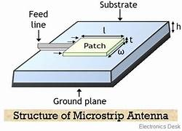
DUAL BAND MONOPOLE ANTENNA
TEAM MEMBERS:
VENKATESH T.P. (927622BEC246)
THARANISH S. (927622BEC231)
UTHAYAN U. (927622BEC239)
THAKSHITH (927622BEC307)
GUIDED BY
Mrs. B.NEETHIYA AADITHIYA

Slide 2
INTRODUCTION:
Monopole antenna : It is a type of radio antenna consists of single rod or wire perpendicular to the ground.
Dual band antenna: It designed to operate efficiency over two distinct frequency bands.

Slide 3
PROBLEM STATEMENT
To reduce the size of the antenna and compact in size. Main aim to the select this project to develop Enchanced public network and the next motive is transferred large number of data.

Slide 4
Objectives:
To design a compact Multiband antenna with improved antenna parameters.

Slide 5
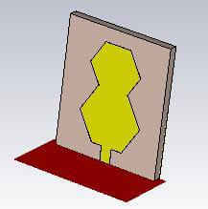
DUAL BAND MONOPLE ANTENNA
The proposed design of the antenna Proposed Antenna parameters
HEIGHT 1.6 mm
DIELECTRIC CONSTANT 3.8 mm
WIDTH 24 mm
LENGTH 20 mm

Slide 6
DESCRIPTION OF ANTENNA
The proposed antenna is designed by using CST studio site software.
According to the results of the simulation, the antenna can operate over a frequency range of 6.53Hz and 8.85Hz first band and second band is 11.571Hz and 12.43Hz
Return loss of first band is -17.34 and second band is -17.14
First bandwidth= 2.314Mhz and Second bandwidth=0.846Mhz

Slide 7
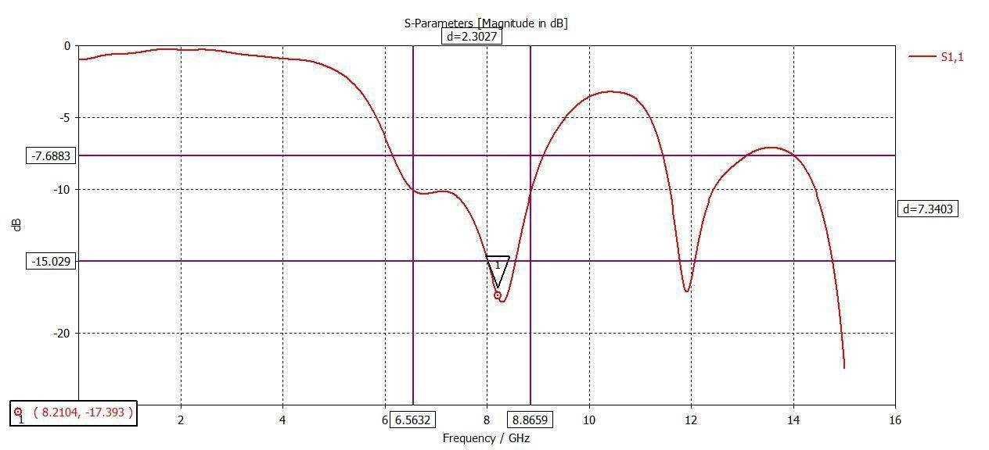
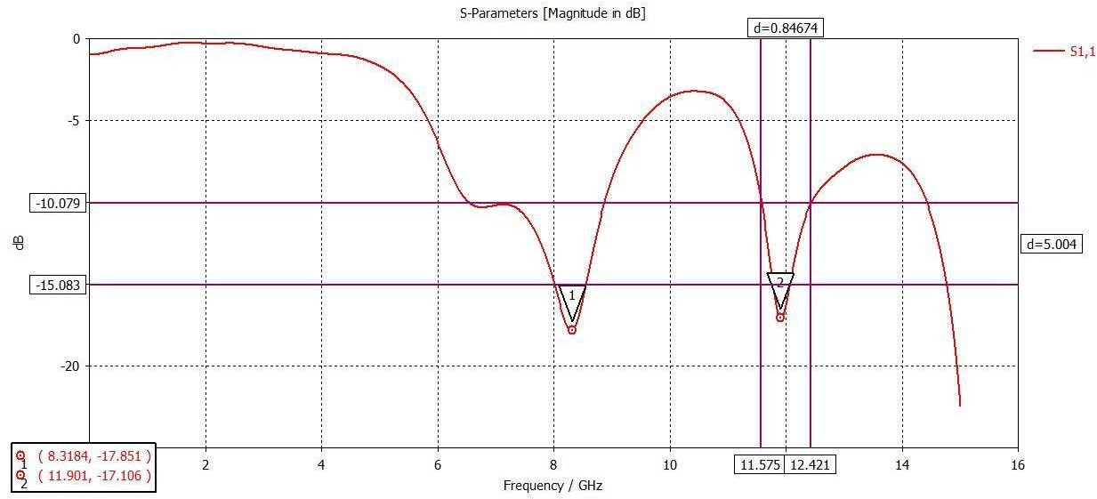
SIMULATION RESULTS (s parameter)
First band
.
Second Band

Slide 8
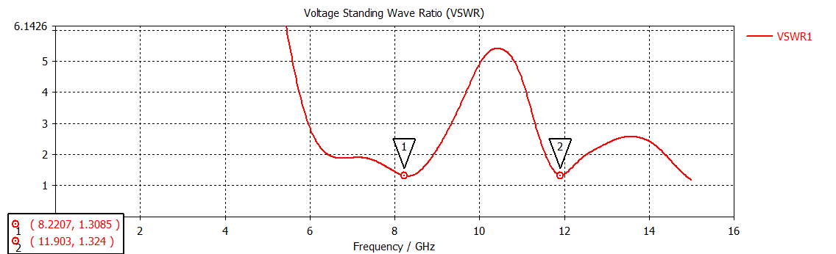
Simulation Results (VSWR)

Slide 9
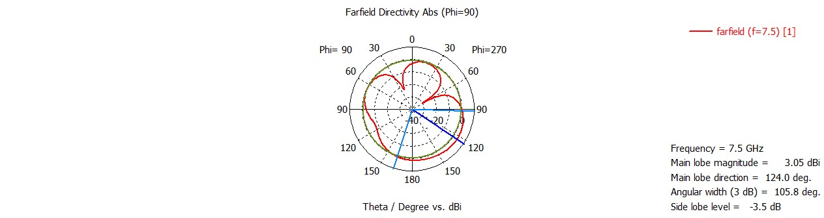
RADIATION PATTERN

Slide 10
APPLICATIONS
High-Frequency Backhaul at 8.31Ghz
Increased Bandwidth
Reduced Congestion
Low Latency
Wireless Communications-11.90Ghz
large number data transfer

Slide 11
CONCLUSION
Designed hexagonal patch antenna.
Got bandwidth=2.314Mhz and 0.846Mhz.
Compact in size.
Dual band.
Materials like that Copper and FR-4

Slide 12
REFERENCES
https://www.mdpi.com/2673-4591/46/1/29#:~:text=Dual%2Dband%20antennas%20provide%20a,a%20result%2C%20a%20narrower%20range.
https://www.researchgate.net/publication/339041820_Antenna_and_Its_Application
https://ieeexplore.ieee.org/document/5996553/
https://www.sciencedirect.com/science/article/abs/pii/S2214785321037093

Slide 13


